Slide 1
McGraw Hill Connect®
Student Registration
Moodle or other LMS Regular Integration

Slide 2
Make the most of Connect
Stay Organized
Digital Course Planner has all your upcoming Connect assignments in one place, and you can customize calendar alerts
Focus On What Matters
Use Reports to track your performance and your understanding of key concepts
Learn On-the-Go
Download the free ReadAnywhere app to take your eBook* and SmartBook® 2.0* with you – online and offline
*ReadAnywhere supports newer eBooks and SmartBook 2.0. may not be available in your Connect course.

Slide 3
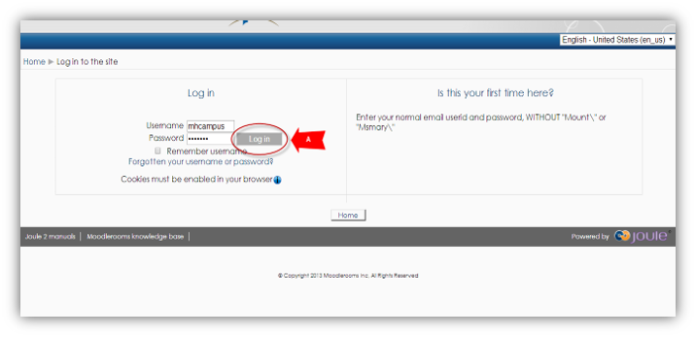
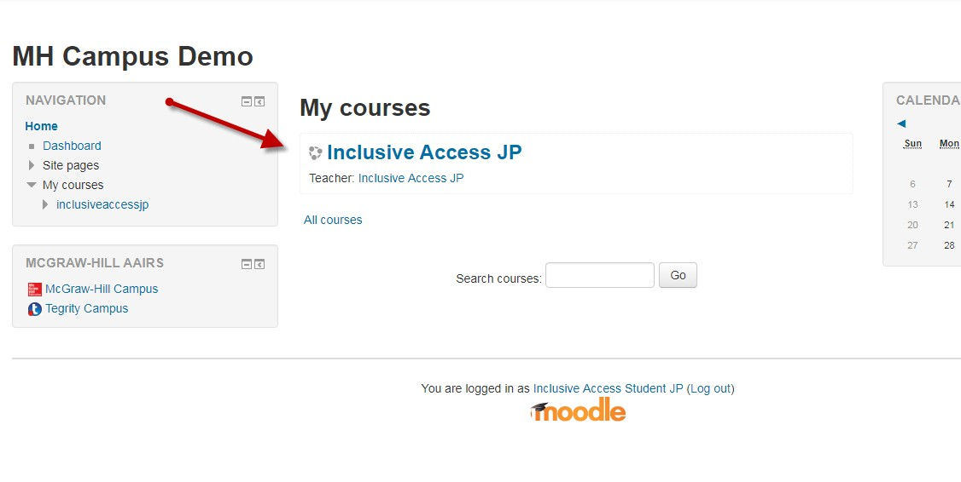
Step 1
Login in to your LMS account and navigate to your course.
If you are not sure if you have an LMS account, check with your instructor.

Slide 4
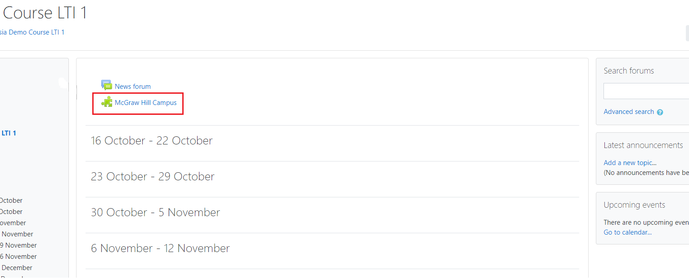
Step 2
On your course homepage, locate and click on the McGraw Hill Campus tool link.
Click on it to start the registration process.

Slide 5
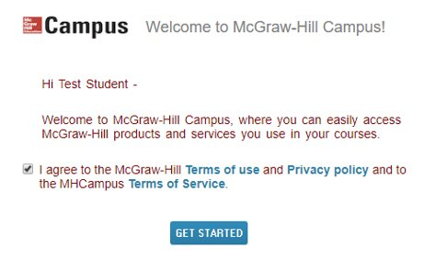
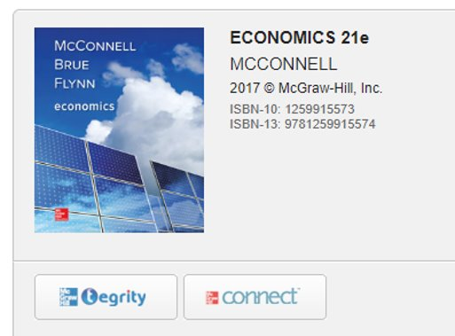
Step 3
If this is your first time using McGraw Hill Campus, you will need to agree to the terms of service and privacy policy and then click Get Started.
​​
Then click on the Connect button to continue.

Slide 6
Step 4
On the next screen, you can look up your account or create an account if you need to.
Enter your email address and click Find my account.
We recommend using your school email address so that all your courses are in one Connect account.

Slide 7
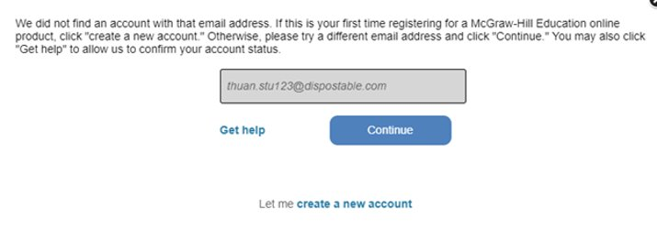
Step 5
If you are a new Connect user, a link to Create a new account will appear below the email form field. Click this link. ​
​On the next screen, click Complete Registration.

Slide 8
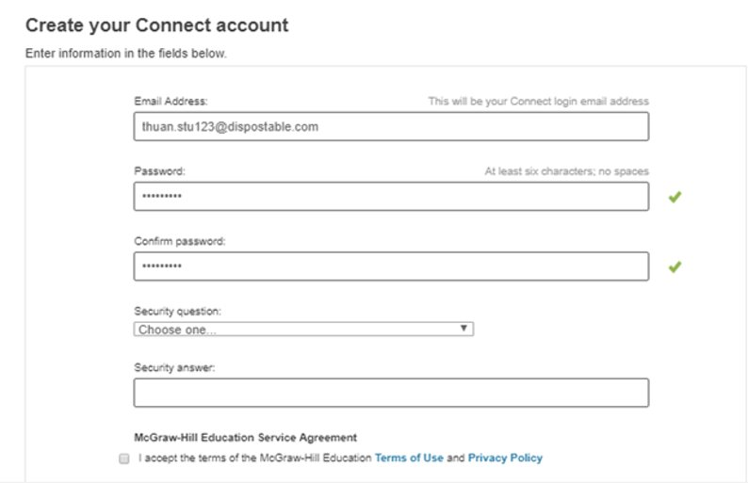
Step 6
Now you can enter in a password and set up a security question in case you need to reset your password.
Check the box to accept the Terms and Conditions, and then click Continue.

Slide 9
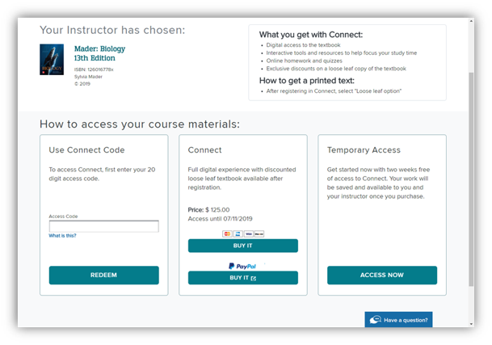
Step 7
You have three registration options.
Connect Code: Enter a Connect access code and click Redeem.
Purchase Online: Click Buy It to use a credit card or PayPal.
Temporary Access: Click Access Now for two-week temporary access.

Slide 10
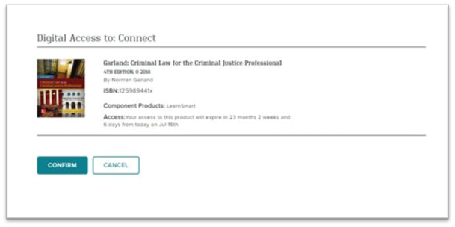
Step 8
Click Confirm. You are now registered.

Slide 11
Support and Resources
TECH SUPPORT & FAQ:
CALL: (800) 331-5094
EMAIL & CHAT: WWW.MHHE.COM/SUPPORT
MONDAY-THURSDAY: 24 hours
FRIDAY: 12 AM - 9 PM EST
SATURDAY: 10 AM - 8 PM EST
SUNDAY: 12 PM – 12 AM EST
FIND MORE TIPS:
WWW.SUPPORTATEVERYSTEP.COM

Slide 12
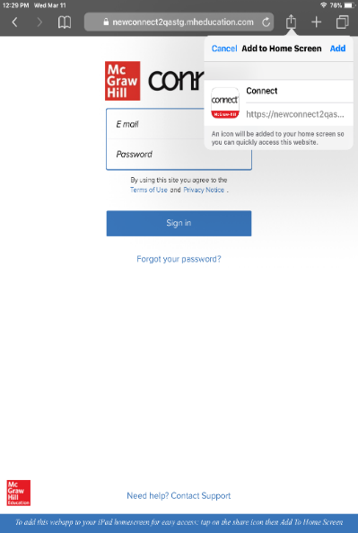
Study on your Smartphone or Tablet
ReadAnywhere App
Download the free ReadAnywhere app to your Android or iOS smartphone or tablet and access your course eBook for offline study access anytime, anywhere.
More than 1 million students and instructors have downloaded the ReadAnywhere app which has a 4.7 rating on the App Store.
Connect Tablet App
Login to Connect on your tablet browser and then add it to your home screen to complete assignments with ease – including pinch, pan, and zoom capability as you work.
*The Connect Tablet App is not recommended for smartphone use.

Slide 13
QUESTIONS?

Slide 14
McGraw Hill Connect and Proctorio
If your instructor uses remote proctoring for this course...
Proctoring and/or browser-locking services will be used within your Connect assignments.
Equipment needed may include a webcam and/or microphone.
Payment may be required.
A practiced proctored assignment may be available
Additional information regarding proctoring may be included in the syllabus.

