Slide 1
SIMnet®
Student Registration
Canvas with Inclusive Access

Slide 2
Benefits of Registering
What do you get when you register for SIMnet?
Hands-on practice with the Microsoft applications you will use in college and your career.
The ability to earn digital badges to showcase on LinkedIn, resumes, and more.
The ability to continue accessing content in your SIMnet library after your course ends.

Slide 3
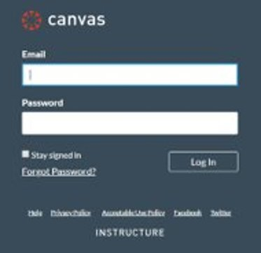
Step 1
Log in to your Canvas account and navigate to your course. ​
If you are not sure if you have a Canvas account, please ask your instructor.​

Slide 4
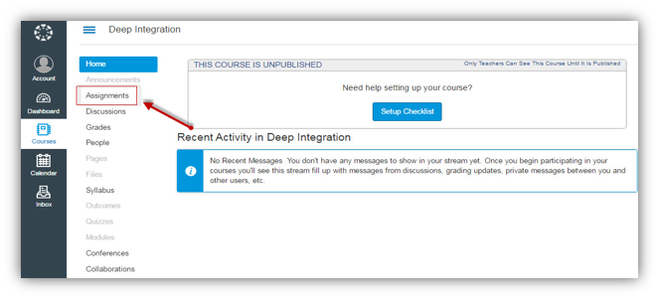
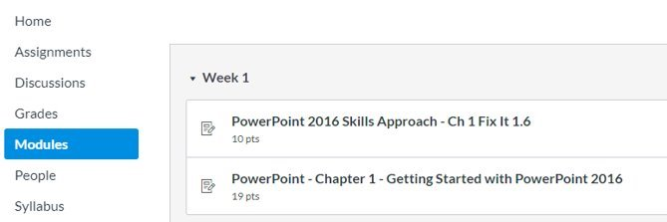
Step 2
Now you will want to find the SIMnet assignment link. It can be listed under the Assignments or Modules in the left navigation area. ​
Once you have found it, click on a SIMnet assignment link to start the registration process.​

Slide 5
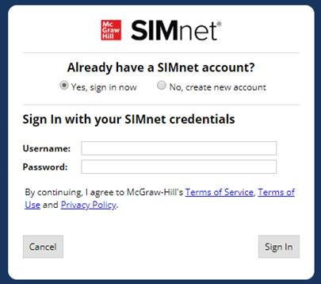
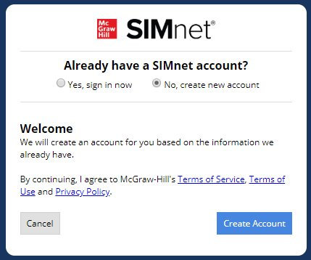
Step 3
Existing SIMnet login: Select Yes, Sign in Now.
Enter your username and password and click Sign-in.
New to SIMnet: Select No, Create new account.
Click Create Account to have your account automatically created for you.

Slide 6
Support & Resources
Tech Support & FAQ:
Call: (800) 331-5094 Email & Chat: www.mhhe.com/support
Find More Tips:
http://www.supportateverystep.com/

Slide 7
QUESTIONS?

